Slide 1
寶可夢、數碼寶貝分類器
淺談機器學習原理
Notes:
TBD:
More complex model
Hoeffding’s Inequality is too fast
=====
overfit
Should we talk about VC?
Meaning of Epsilon representive
======
Validation
More to consider
Before the formulation
Formulation
Experiemnt
=====
Outline
0. Introducing the task
Although training and testing are sampled from the same distribution, it is possible to fail.
The probability of fail.
There are two errors.
Validation
https://nowak.ece.wisc.edu/SLT07/lecture7.pdf

Slide 2


Review: Basic Idea of ML
Step 1: function with unknown
Step 2: define loss
Step 3: optimization
https://youtu.be/Ye018rCVvOo
https://youtu.be/bHcJCp2Fyxs

Slide 3

Review: Strategy
https://youtu.be/WeHM2xpYQpw
More parameters, easier to overfit. Why?

Slide 4

Case Study: Pokémon v.s. Digimon
https://medium.com/@tyreeostevenson/teaching-a-computer-to-classify-anime-8c77bc89b881

Slide 5

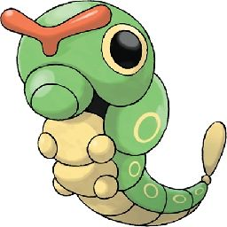
Pokémon vs. Digimon
這是數碼寶貝
的蟲蟲獸
這才是寶可夢
的綠毛蟲

Slide 6


Pokémon vs. Digimon
小智身邊有小火龍
太一身邊有亞古獸

Slide 7


Pokémon/Digimon Classifier
We want to find a function ……
Pokémon or Digimon
$$f\left( \right)=$$
Determine a function with unknown parameters (based on domain knowledge)
Notes:
https://linuxtut.com/en/58532c06a3af3324d970/

Slide 8



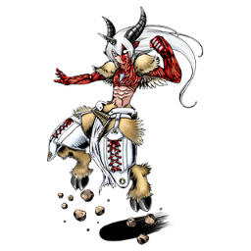


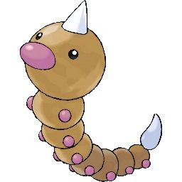
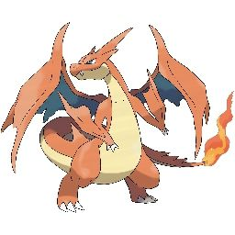


Observation
Digimon
線條較複雜?
Pokémon
線條較簡單?

Slide 9
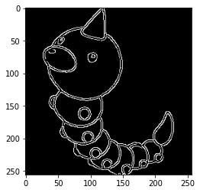

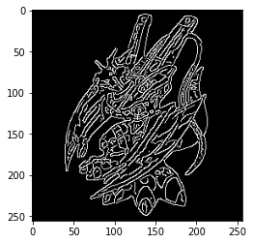


Observation
$$e\left( \right)=3558$$
Edge detection
3558
$$e\left( \right)=7389$$
7389
Notes:
Edge detection
獨角重 鐵殼永 大針鋒

Slide 10

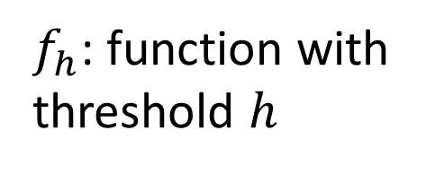
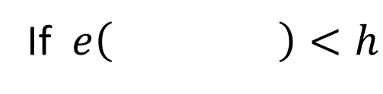
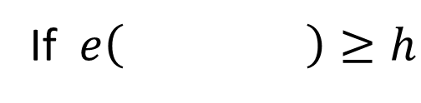

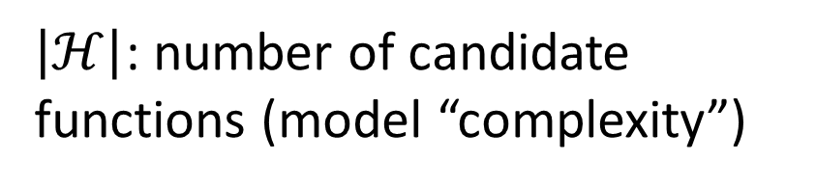
Function with Unknown Parameters
Digimon
If $e\left( \right)≥h$
$$f\left( \right)=$$
Pokémon
$f_{h}$: function with threshold $h$
If $e\left( \right)<h$
$$ℋ=\left\{1,2,⋯,10,000\right\}$$
$\left|ℋ\right|$: number of candidate functions (model “complexity”)
Notes:
How to determine $h$? Let’s use data.

Slide 11
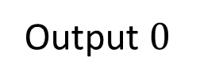
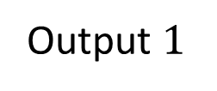

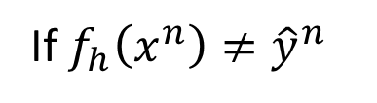
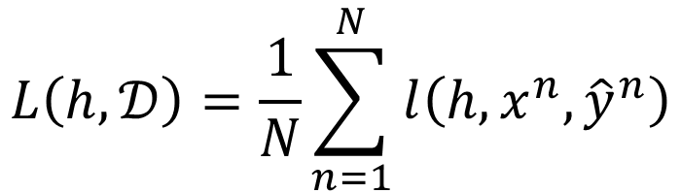

Loss of a function (given data)
Pokémon
Given a dataset $𝒟$
Loss of a threshold $h$ given data set $𝒟$
$$𝒟=\left\{\left(x^{1},{\hat{y}}^{1}\right),\left(x^{2},{\hat{y}}^{2}\right),⋯,\left(x^{N},{\hat{y}}^{N}\right)\right\}$$
$$L\left(h,𝒟\right)=\frac{1}{N}\sum_{n=1}^{N}{l\left(h,x^{n},{\hat{y}}^{n}\right)}$$
$$I\left(f_{h}\left(x^{n}\right)≠{\hat{y}}^{n}\right)$$
Error rate
If $f_{h}\left(x^{n}\right)≠{\hat{y}}^{n}$
Output $1$
Don’t like it?
Of course, you can choose cross-entropy. ☺
Otherwise
Output $0$

Slide 12
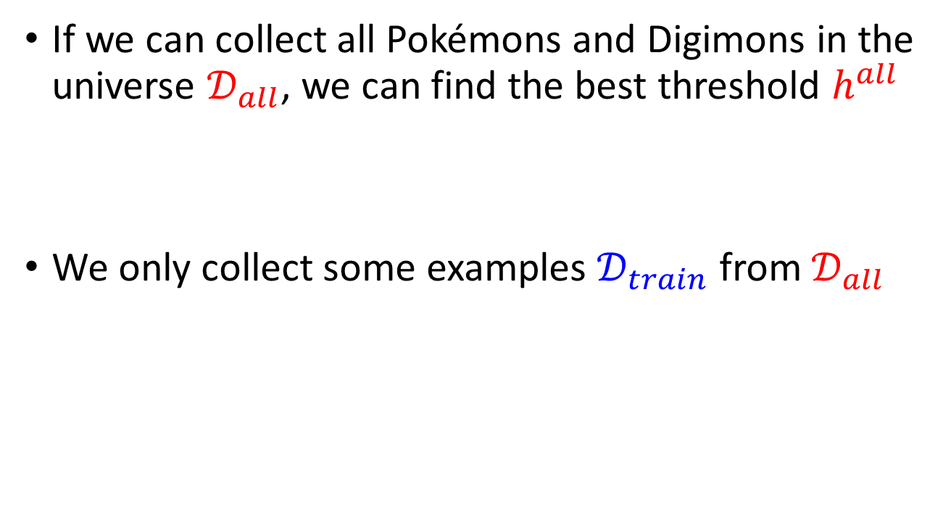



Training Examples
If we can collect all Pokémons and Digimons in the universe $𝒟_{all}$, we can find the best threshold $h^{all}$
We only collect some examples $𝒟_{train}$ from $𝒟_{all}$
$$h^{all}=arg\min_{h}{L\left(h,𝒟_{all}\right)}$$
$$𝒟_{train}=\left\{\left(x^{1},{\hat{y}}^{1}\right),\left(x^{2},{\hat{y}}^{2}\right),⋯,\left(x^{N},{\hat{y}}^{N}\right)\right\}$$
$$\left(x^{n},{\hat{y}}^{n}\right)\sim 𝒟_{all}$$
independently and identically distributed (i.i.d.)
$$h^{train}=arg\min_{h}{L\left(h,𝒟_{train}\right)}$$

Slide 13


Training Examples
If we can collect all Pokémons and Digimons in the universe $𝒟_{all}$, we can find the best threshold $h^{all}$
We only collect some examples $𝒟_{train}$ from $𝒟_{all}$
$$h^{all}=arg\min_{h}{L\left(h,𝒟_{all}\right)}$$
理想
$$h^{train}=arg\min_{h}{L\left(h,𝒟_{train}\right)}$$
現實
We hope $L\left(h^{train},𝒟_{all}\right)$ and $L\left(h^{all},𝒟_{all}\right)$ are close.
現實
理想

Slide 14
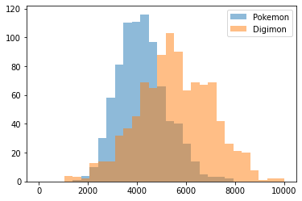
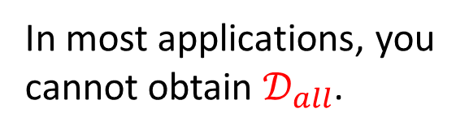
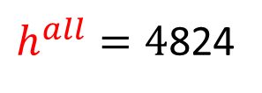


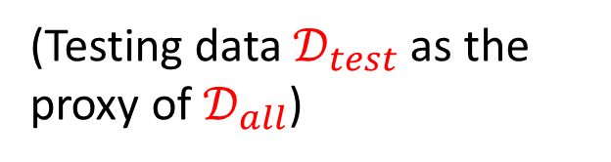
We hope $L\left(h^{train},𝒟_{all}\right)$ and $L\left(h^{all},𝒟_{all}\right)$ are close.
All Pokémons and Digimons we know as $𝒟_{all}$
Pokémon: 819
Digimon: 971
In most applications, you cannot obtain $𝒟_{all}$.
(Testing data $𝒟_{test}$ as the proxy of $𝒟_{all}$)
Source of Digimon: https://github.com/mrok273/Qiita
Source of Pokémon: https://www.kaggle.com/kvpratama/pokemon-images-dataset/data
$h^{all}=4$824
$$L\left(h^{all},𝒟_{all}\right)=0.28$$
Notes:
Testing data: 4907 0.71
4824 0.7217877094972067

Slide 15
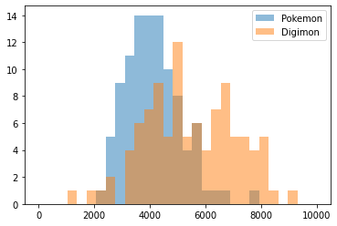


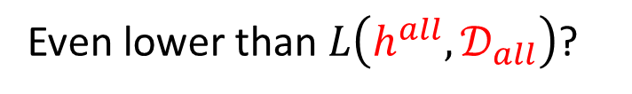
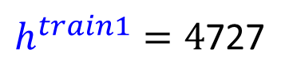

We hope $L\left(h^{train},𝒟_{all}\right)$ and $L\left(h^{all},𝒟_{all}\right)$ are close.
Sample 200 Pokémons and Digimons as $𝒟_{train1}$
All Pokémons and Digimons we know as $𝒟_{all}$
$h^{train1}=4$727
$h^{all}=4$824
$$L\left(h^{train1},𝒟_{train1}\right)=0.27$$
$$L\left(h^{all},𝒟_{all}\right)=0.28$$
Even lower than $L\left(h^{all},𝒟_{all}\right)$?
$$L\left(h^{train1},𝒟_{all}\right)=0.28$$
Notes:
Testing data: 4907 0.71
4824 0.7217877094972067

Slide 16
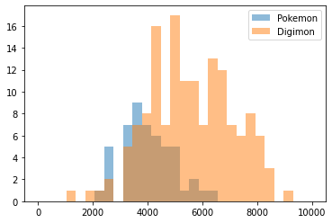




We hope $L\left(h^{train},𝒟_{all}\right)$ and $L\left(h^{all},𝒟_{all}\right)$ are close.
Sample 200 Pokémons and Digimons as $𝒟_{train2}$
All Pokémons and Digimons we know as $𝒟_{all}$
$$h^{train2}=3642$$
$h^{all}=4$824
$$L\left(h^{train2},𝒟_{train2}\right)=0.20$$
$$L\left(h^{all},𝒟_{all}\right)=0.28$$
$$L\left(h^{train2},𝒟_{all}\right)=0.37$$
Notes:
Testing data: 4907 0.71
4824 0.7217877094972067

Slide 17

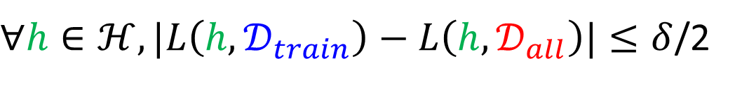
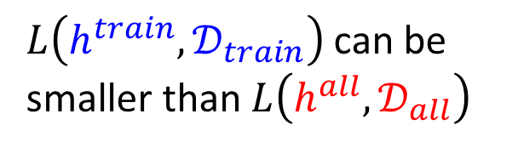
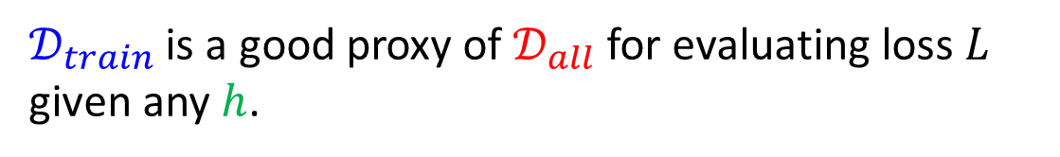

What do we want?
$L\left(h^{train},𝒟_{train}\right)$ can be smaller than $L\left(h^{all},𝒟_{all}\right)$
$$L\left(h^{train},𝒟_{all}\right)−L\left(h^{all},𝒟_{all}\right)≤δ$$
We want
What kind of $𝒟_{train}$ fulfill it?
$∀h∈ℋ,|L\left(h,𝒟_{train}\right)−L\left(h,𝒟_{all}\right)|≤δ$/2
$𝒟_{train}$ is a good proxy of $𝒟_{all}$ for evaluating loss $L$ given any $h$.
Notes:
Can we always get good performance on $L\left(h^{∗},𝒟_{train}\right)$ ?

Slide 18


What do we want?
$$L\left(h^{train},𝒟_{all}\right)−L\left(h^{all},𝒟_{all}\right)≤δ$$
We want
What kind of $𝒟_{train}$ fulfill it?
$∀h∈ℋ,|L\left(h,𝒟_{train}\right)−L\left(h,𝒟_{all}\right)|≤δ$/2
$$L\left(h^{train},𝒟_{all}\right)≤L\left(h^{train},𝒟_{train}\right)+δ\text{/2}$$
$$≤L\left(h^{all},𝒟_{train}\right)+δ\text{/2}$$
$$h^{train}=arg\min_{h}{L\left(h,𝒟_{train}\right)}$$
$$≤L\left(h^{all},𝒟_{all}\right)+δ\text{/2}+δ\text{/2}$$
$$=L\left(h^{all},𝒟_{all}\right)+δ$$
Notes:
Can we always get good performance on $L\left(h^{∗},𝒟_{train}\right)$ ?

Slide 19
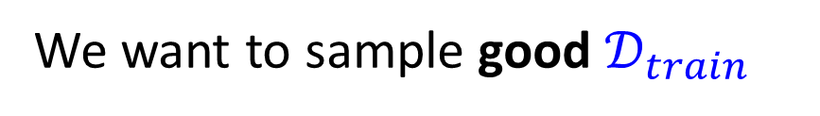

What do we want?
$$L\left(h^{train},𝒟_{all}\right)−L\left(h^{all},𝒟_{all}\right)≤δ$$
We want
What kind of $𝒟_{train}$ fulfill it?
$∀h∈ℋ,|L\left(h,𝒟_{train}\right)−L\left(h,𝒟_{all}\right)|≤δ$/2
We want to sample good $𝒟_{train}$
$$ε=δ\text{/2}$$
$$∀h∈ℋ,|L\left(h,𝒟_{train}\right)−L\left(h,𝒟_{all}\right)|≤ε$$
What is the probability of sampling bad $𝒟_{train}$?
Notes:
Can we always get good performance on $L\left(h^{∗},𝒟_{train}\right)$ ?

Slide 20
Very General!
The following discussion is model-agnostic.
In the following discussion, we don’t have assumption about data distribution.
In the following discussion, we can use any loss function.

Slide 21




Probability of Failure
good $𝒟_{train}$
$𝒟_{train2}$
bad $𝒟_{train}$
$𝒟_{train1}$
Each point is a training set.
Notes:
Can we always get good performance on $L\left(h^{∗},𝒟_{train}\right)$ ?

Slide 22

Probability of Failure
Each point is a training set.
$$P\left(𝒟_{train} is bad\right)$$
Notes:
Can we always get good performance on $L\left(h^{∗},𝒟_{train}\right)$ ?

Slide 23




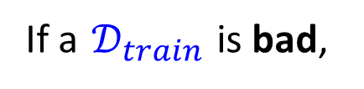

Probability of Failure
Each point is a training set.
If a $𝒟_{train}$ is bad,
at least one $h$ makes $|L\left(h,𝒟_{train}\right)−L\left(h,𝒟_{all}\right)|>ε$
$$P\left(𝒟_{train} is bad due to h_{1}\right)$$
$$P\left(𝒟_{train} is bad due to h_{2}\right)$$
$$h_{2}$$
$$h_{1}$$
$$h_{3}$$
Notes:
Can we always get good performance on $L\left(h^{∗},𝒟_{train}\right)$ ?

Slide 24
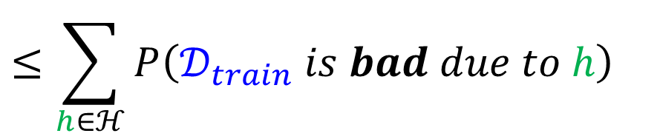
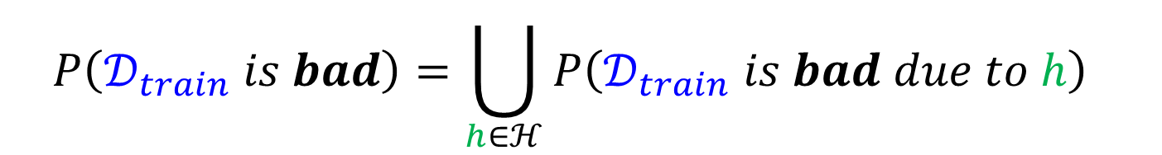
$$P\left(𝒟_{train} is bad\right)=\bigcup_{h∈ℋ}{P\left(𝒟_{train} is bad due to h\right) }$$
$$≤\sum_{h∈ℋ}{P\left(𝒟_{train} is bad due to h\right)}$$
$$h_{2}$$
$$h_{1}$$
$$h_{3}$$
Notes:
Can we always get good performance on $L\left(h^{∗},𝒟_{train}\right)$ ?

Slide 25

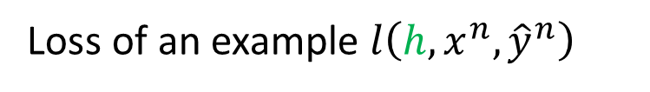


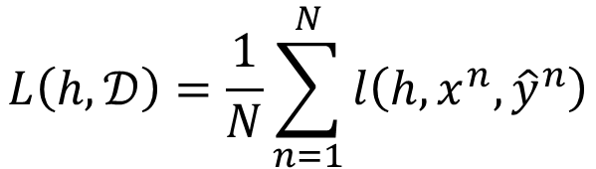
$$P\left(𝒟_{train} is bad\right)=\bigcup_{h∈ℋ}{P\left(𝒟_{train} is bad due to h\right) }$$
$$≤\sum_{h∈ℋ}{P\left(𝒟_{train} is bad due to h\right)}$$
$$L\left(h,𝒟\right)=\frac{1}{N}\sum_{n=1}^{N}{l\left(h,x^{n},{\hat{y}}^{n}\right)}$$
$$|L\left(h,𝒟_{train}\right)−L\left(h,𝒟_{all}\right)|>ε$$
Loss of an example $l\left(h,x^{n},{\hat{y}}^{n}\right)$
……
$$L\left(h,𝒟_{all}\right)$$
Average
$$L\left(h,𝒟_{train}\right)$$
Average
Notes:
Can we always get good performance on $L\left(h^{∗},𝒟_{train}\right)$ ?

Slide 26

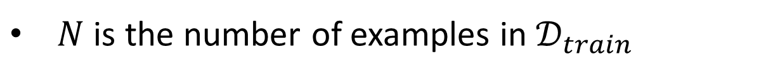


$$P\left(𝒟_{train} is bad\right)=\bigcup_{h∈ℋ}{P\left(𝒟_{train} is bad due to h\right) }$$
$$≤\sum_{h∈ℋ}{P\left(𝒟_{train} is bad due to h\right)}$$
Hoeffding’s Inequality:
$$P\left(𝒟_{train} is bad due to h\right)$$
$$≤2exp\left(−2Nε^{2}\right)$$
The range of loss $L$ is $\left[0,1\right]$
$N$ is the number of examples in $𝒟_{train}$
Notes:
Can we always get good performance on $L\left(h^{∗},𝒟_{train}\right)$ ?

Slide 27
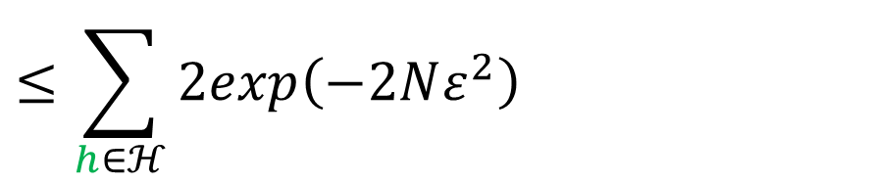

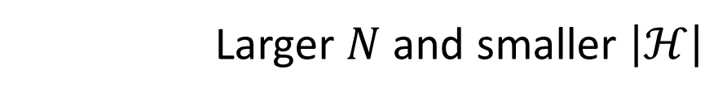
$$P\left(𝒟_{train} is bad\right)=\bigcup_{h∈ℋ}{P\left(𝒟_{train} is bad due to h\right) }$$
$$≤\sum_{h∈ℋ}{P\left(𝒟_{train} is bad due to h\right)}$$
$$≤\sum_{h∈ℋ}{2exp\left(−2Nε^{2}\right)}$$
$$=\left|ℋ\right|∙2exp\left(−2Nε^{2}\right)$$
How to make $P\left(𝒟_{train} is bad\right)$ smaller?
Larger $N$ and smaller $\left|ℋ\right|$
Notes:
Can we always get good performance on $L\left(h^{∗},𝒟_{train}\right)$ ?

Slide 28







$$P\left(𝒟_{train} is bad\right)≤\left|ℋ\right|∙2exp\left(−2Nε^{2}\right)$$
Larger $N$
$$h_{1}$$
$$h_{2}$$
$$h_{2}$$
$$h_{1}$$
$$h_{3}$$
$$h_{3}$$

Slide 29



$$P\left(𝒟_{train} is bad\right)≤\left|ℋ\right|∙2exp\left(−2Nε^{2}\right)$$
Smaller $\left|ℋ\right|$
$$h_{1}$$
$$h_{1}$$
$$h_{2}$$
$$h_{3}$$
$$h_{3}$$

Slide 30

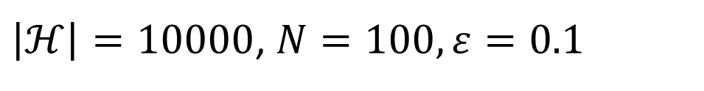
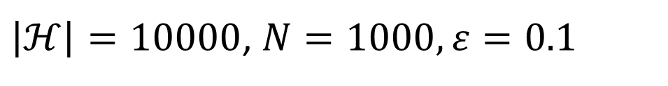

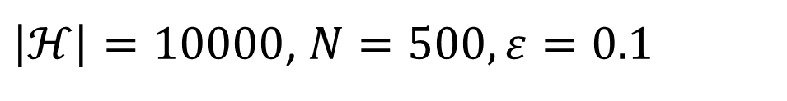


Example
$$ℋ=\left\{1,2,⋯,10,000\right\}$$
$$𝒟_{train}=\left\{\left(x^{1},{\hat{y}}^{1}\right),\left(x^{2},{\hat{y}}^{2}\right),⋯,\left(x^{N},{\hat{y}}^{N}\right)\right\}$$
$$∀h∈ℋ,|L\left(h,𝒟_{train}\right)−L\left(h,𝒟_{all}\right)|≤ε$$
$$P\left(𝒟_{train} is bad\right)≤\left|ℋ\right|∙2exp\left(−2Nε^{2}\right)$$
$\left|ℋ\right|=10000$, $N=100,ε=0.1$
Usually happen QQ
$$P\left(𝒟_{train} is bad\right)≤2707$$
$\left|ℋ\right|=10000$, $N=500,ε=0.1$
$$P\left(𝒟_{train} is bad\right)≤0.91$$
$\left|ℋ\right|=10000$, $N=1000,ε=0.1$
$$P\left(𝒟_{train} is bad\right)≤\text{0.00004}$$

Slide 31
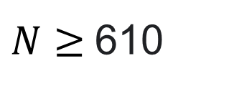
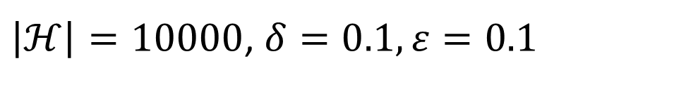
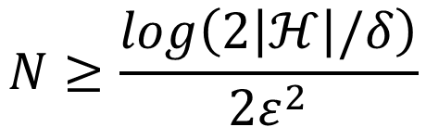

Example
$$P\left(𝒟_{train} is bad\right)≤\left|ℋ\right|∙2exp\left(−2Nε^{2}\right)$$
If we want $P\left(𝒟_{train} is bad\right)≤δ$
How many training examples do we need?
$$N≥\frac{log\left(2\left|ℋ\right|/δ\right)}{2ε^{2}}$$
$$\left|ℋ\right|∙2exp\left(−2Nε^{2}\right)≤δ$$
$\left|ℋ\right|=10000$, $δ=0.1,ε=0.1$
$N≥$610

Slide 32
Model Complexity
$$P\left(𝒟_{train} is bad\right)≤\left|ℋ\right|∙2exp\left(−2Nε^{2}\right)$$
The number of possible functions you can select
What if the parameters are continuous?
Answer 1: Everything that happens in a computer is discrete. ☺
Answer 2: VC-dimension (not this course)
Notes:
Loss function is not accuracy

Slide 33



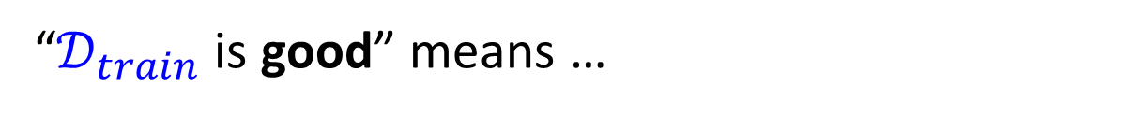
Model Complexity
$$P\left(𝒟_{train} is bad\right)≤\left|ℋ\right|∙2exp\left(−2Nε^{2}\right)$$
Why don’t we simply use a very small $\left|ℋ\right|$?
理想崩壞
“$𝒟_{train}$is good” means …
$$∀h∈ℋ,|L\left(h,𝒟_{train}\right)−L\left(h,𝒟_{all}\right)|≤ε$$
Larger loss
$$L\left(h^{train},𝒟_{all}\right)−L\left(h^{all},𝒟_{all}\right)≤δ$$
$$ε=δ\text{/2}$$
$$h^{all}=arg\min_{h∈ℋ}{L\left(h,𝒟_{all}\right)}$$
fewer candidates

Slide 34
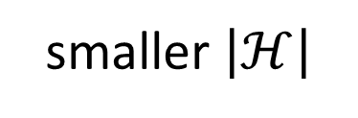
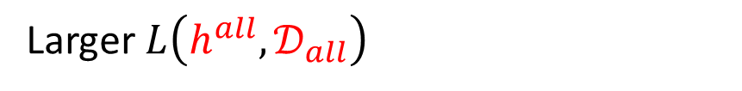



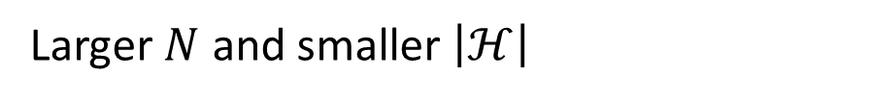


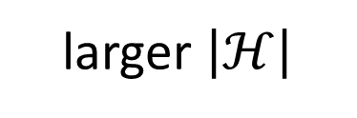
Tradeoff of Model Complexity
Larger $N$ and smaller $\left|ℋ\right|$
$$L\left(h^{train},𝒟_{all}\right)−L\left(h^{all},𝒟_{all}\right)≤δ$$
Larger $L\left(h^{all},𝒟_{all}\right)$
Smaller $\left|ℋ\right|$
larger $\left|ℋ\right|$
smaller $\left|ℋ\right|$
$$L\left(h^{train},𝒟_{all}\right)$$
$$L\left(h^{train},𝒟_{all}\right)$$
small
large
large
$$L\left(h^{all},𝒟_{all}\right)$$
small
$$L\left(h^{all},𝒟_{all}\right)$$
魚與熊掌可以兼得嗎？
Yes, Deep Learning.

Slide 35

https://forms.gle/FKGwMczbJPxnWe9o7

